Slide 1
Spreadsheets
COE 201- Computer Proficiency
Mr. Ahmad Al Kawam

Slide 2
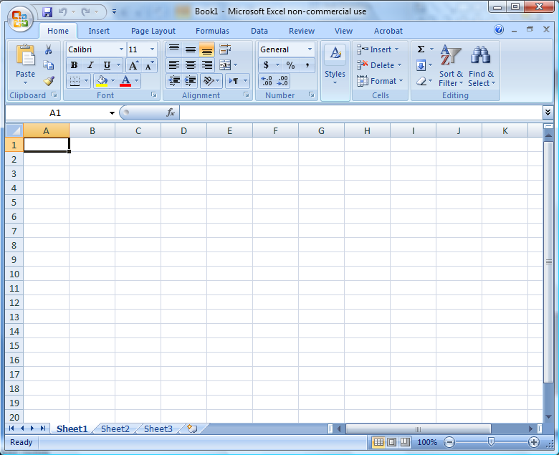
Basic Interface
Excel Book = Word Document
Every book can contain up to 255 different sheets

Slide 3
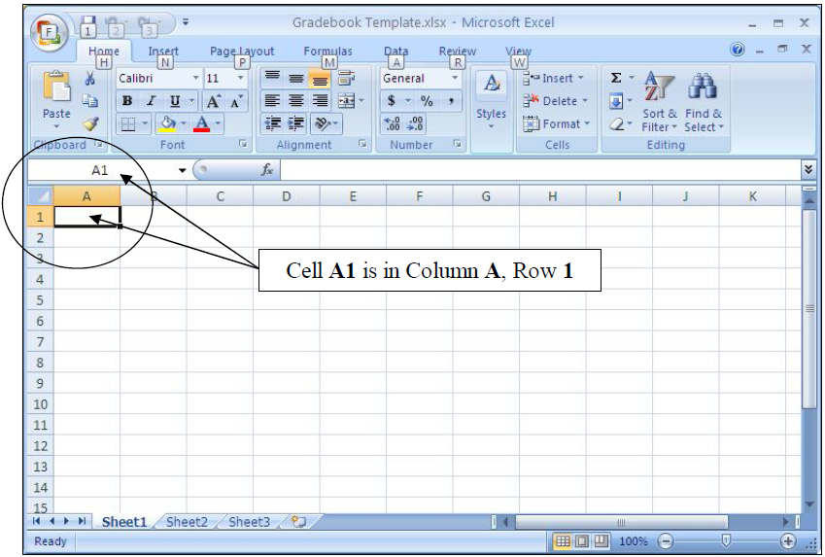
Cell Referencing
Every sheet contains :
Office 2003
256 columns
65,536 rows
Office 2007
16384 columns
1048576 rows
Every cell can be accessed by specifying its
Column
Row
Ex: cell A1

Slide 4
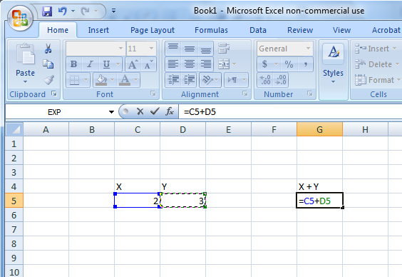
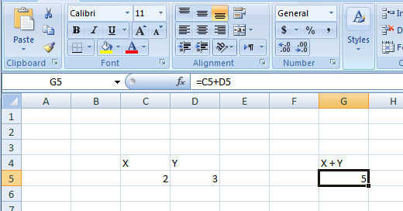
Relative Cell Referencing
A simple example of relative cell referencing:
A formula has to start with an ‘=‘ sign or else, it will be interpreted as text.

Slide 5
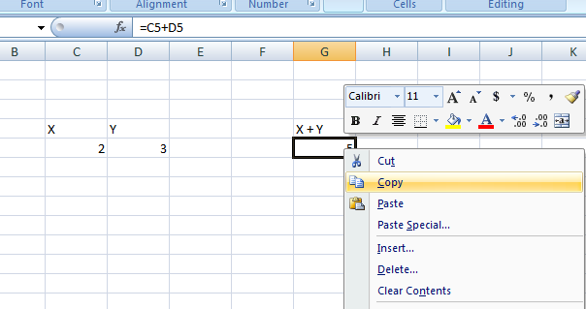
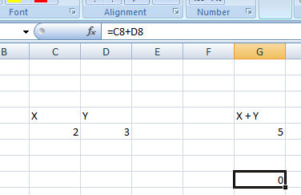
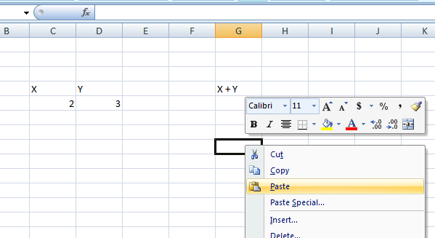
Copy – Paste with Cells
1
3
2
Notice the pasted value in G8: Check the referencing!!
What happened?

Slide 6
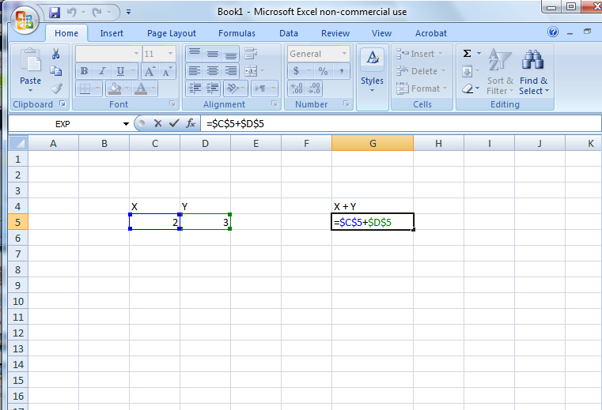
Absolute Referencing
Notice the modified referencing
(using the ‘$’ sign)
Now repeat the same procedure as in relative referencing…
Do you see the difference?
Absolute Referencing types:
$An : Freeze the column
A$n :Freeze the row
$A$n :Freeze the column and the row

Slide 7
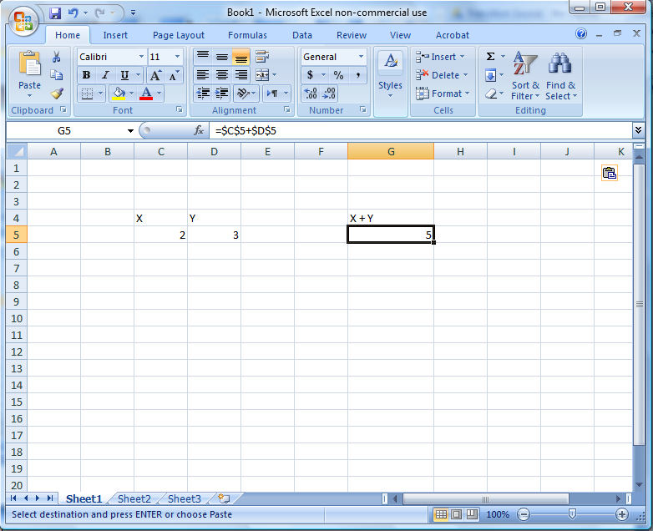
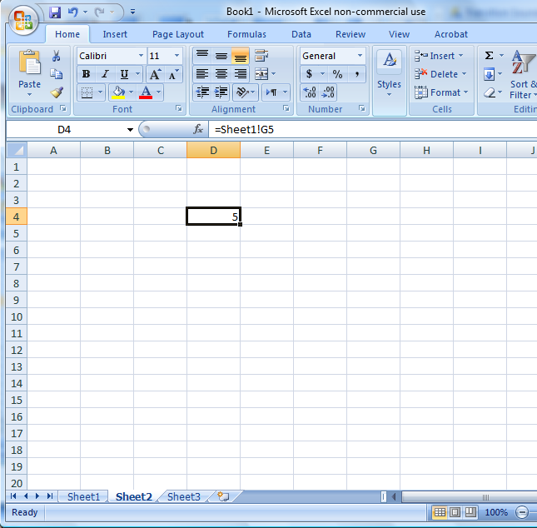
Complex Referencing
To reference another sheet, use the ‘SHEETNAME!’ before the cell reference.
To reference another book, use the ‘[BOOKNAME]SHEETNAME!’ before the reference.

Slide 8
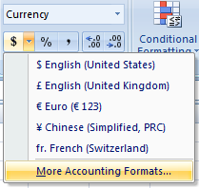
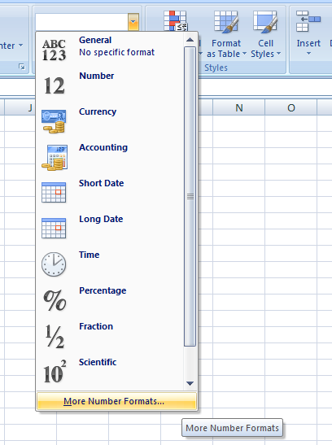
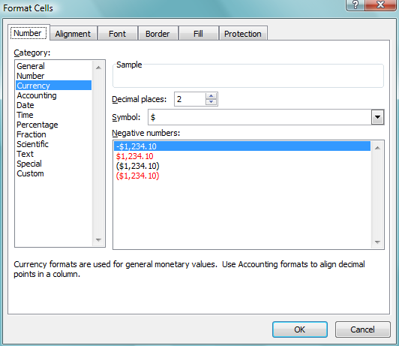
Cell Formatting
Use the ‘Number Format’ menu under ‘Home’ to modify the appearance of one or more of your cells

Slide 9
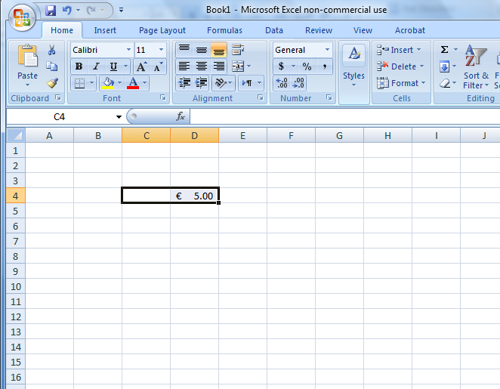
Cell Merging
or
‘Merge cells’ will merge your selected cells into one cell referenced by the top-leftmost cell in the selection.
All other cell will lose their values!!!

Slide 10
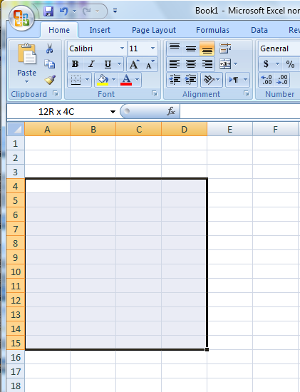
The Range
A range is a rectangular area you define in a sheet
Range: (Am:Bn)
Am is the top-leftmost cell in the range
Bn is the bottom-rightmost cell in the same range.

Slide 11
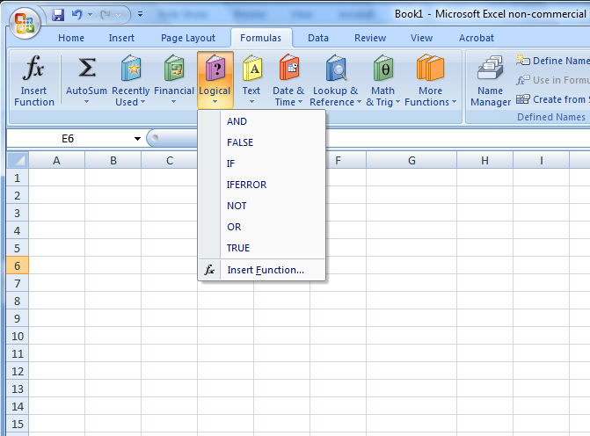
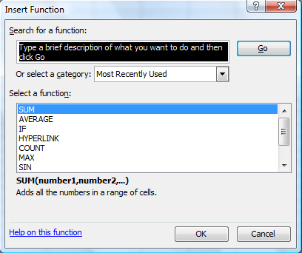
Functions

Slide 12
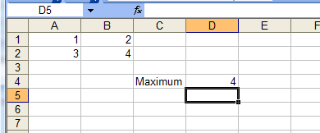
Function (continued)
MAXimum
MINimum
Notice the range usage in the MIN and MAX functions

Slide 13
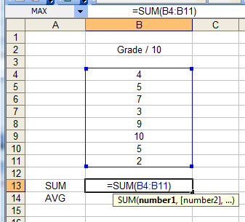
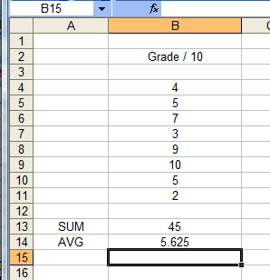
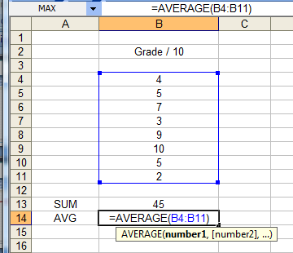
Function (continued)
SUMmation
AVeraGe (AVG)

Slide 14
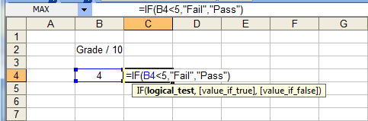
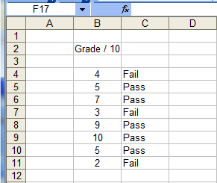
Function (continued)
The IF function
Syntax: “=IF(condition to test, value to insert in the condition is true, value to insert if the condition is false)

Slide 15
Function (continued)
The IF function
You can imbricate multiple IF functions together:
=IF(condition 1, IF(condition2, results2a, result2b), result 1b)
To try: The Elections Eligibility System
Age above 21
Eligible to vote
Eligible to run for the elections
Age between 18 and 21
Eligible to vote
NOT eligible to run for the elections
Age below 18
NOT Eligible to vote
NOT eligible to run for the elections

Slide 16
Other Functions
More interesting/ Challenging functions to try:
COUNT, COUNTIF, COUNTBLANK
HLOOKUP, VLOOKUP

Slide 17
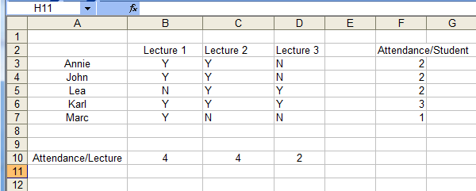
The COUNTIF function
Count if equal to Y…

Slide 18
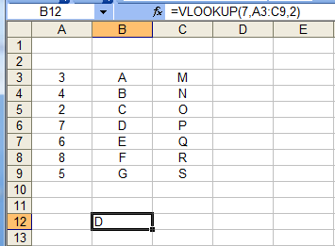
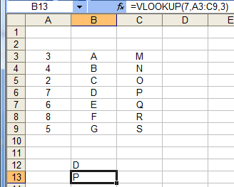
HLOOKUP and VLOOKUP

Slide 19
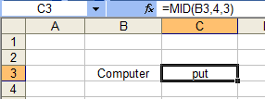
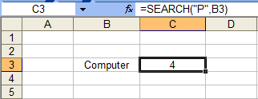
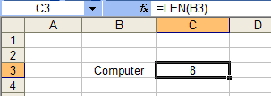
String Operations
LEFT, RIGHT, MID, LEN, SEARCH…
Select the first 4 characters in B3
(last 4 characters if RIGHT)
Select 3 characters in B3, starting with the 4th character
The first occurrence of “P” in B3
The length of B3
Notice: Strings have to be enclosed with double quotes “ “.

Slide 20
Example
Slice your Full Name into two parts
First Name
Last Name
Create a password based on the following rule:
First Letter of the first name
First Letter of the last name
The ID number
ALL IN LOWERCASE

Slide 21
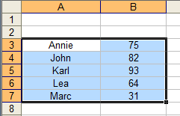
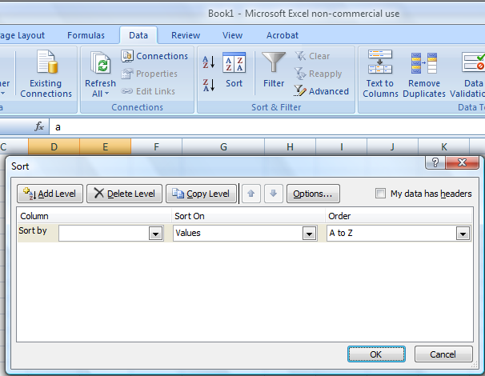
Sorting
1
3
Sorted by Alphabetical Order (A-Z)
2
Column A

Slide 22
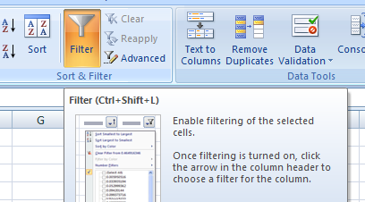
Filtering your Data
Auto-Filtering Feature
AutoFilter Pop-ups

Slide 23
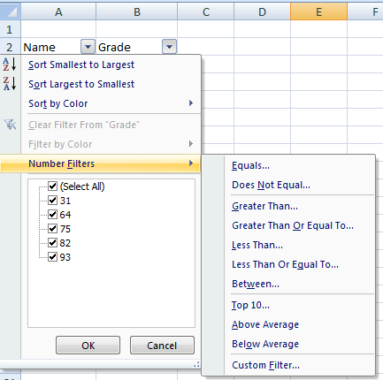
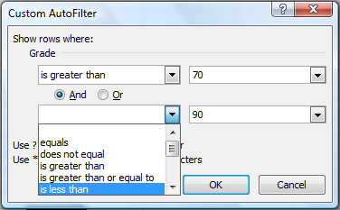
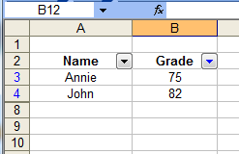
Filtering your Data
1
2
3

Slide 24
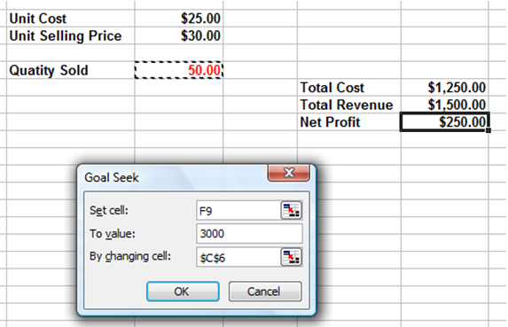
Goal Seek
Data → What-If Analysis → Goal Seek
1
2

Slide 25
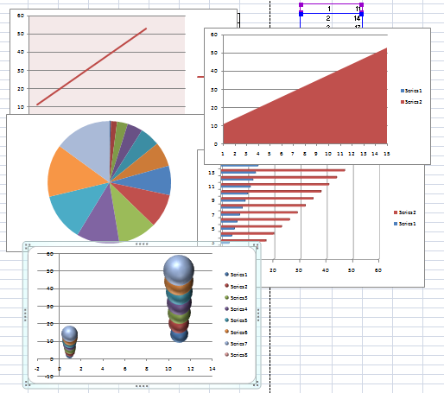
Charts
Excel can plot data using several types of charts based on the nature of the data.
You can plot the data using pie-charts, Bar-charts, lines, columns and even areas.

Slide 26
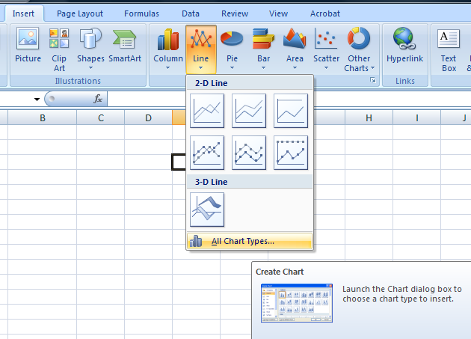
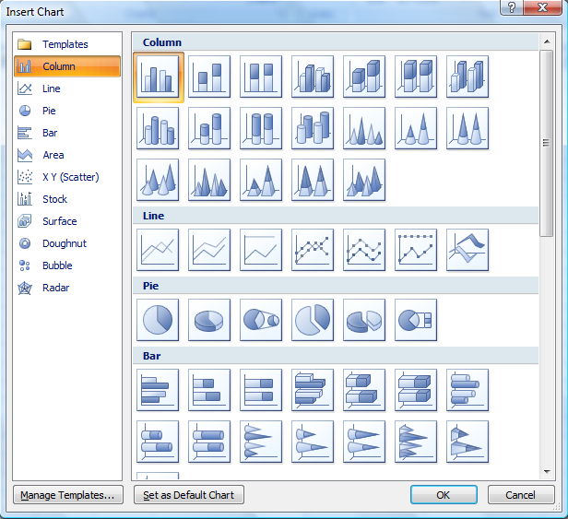
Charts

Slide 27
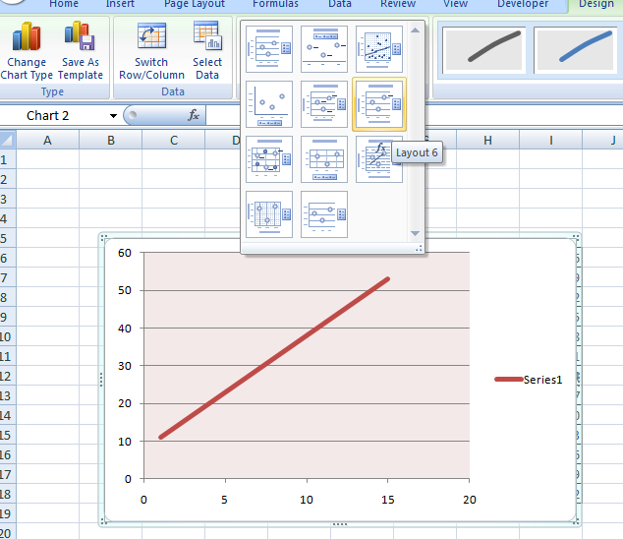
Editing Charts
Click on the chart
Edit or add
Grid
Labels
Chart title
Legend
Line color
Background color

Slide 28
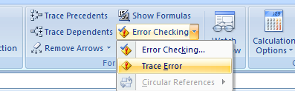
Troubleshooting Formulas

Slide 29
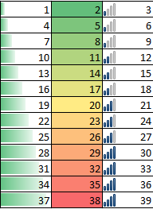
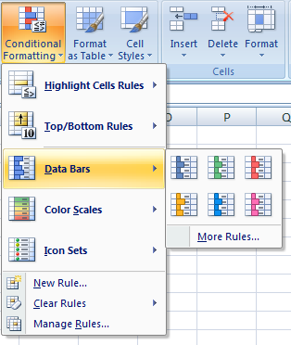
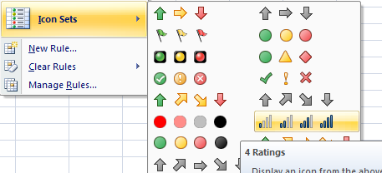
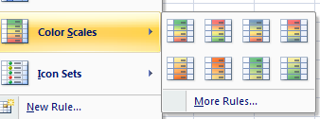
Conditional Formatting
Create trigger states
automatically flag cells for attention.

